Slide 1
Rock, Paper, Scissors
JavaScript Coding Game Project
© Tech Twins, LLC. All Rights Reserved.

Slide 2
Part 1- Coding

Slide 3
Directions:
Save As: RockPaperScissors.html
Objective: You will practice coding a game with the JavaScript with the knowledge you have previously learned. The game you create will have the user play the computer in a rock, paper, scissors game. Follow the instructions below to get started. Always refer to previous coding lessons and the Coding Cheat Sheet when you need help.
Directions:
During this project you will be working independently.
You are to create a new file for this game project. Title the file as “RockPaperScissors.html.”
The answers to coding this game will be shown on the next slide. This will allow you to practice the steps for coding your first game.
After all documents are saved, run and debug your coding on the internet so you can check your work.
Save when you are done with your student drive.

Slide 4
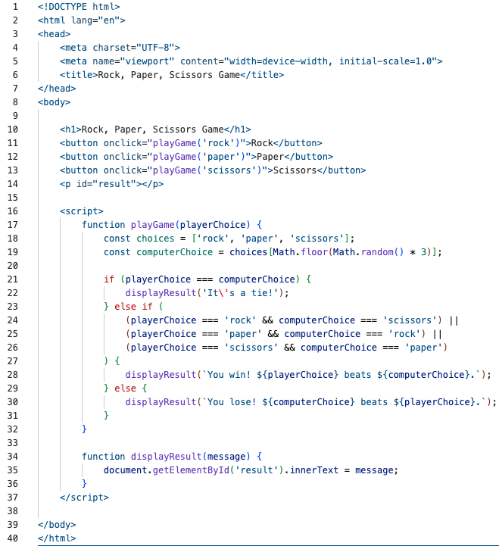
Rock, Paper, Scissors- Coding Key
Write the lines of code shown below to code your first coding game!
Total Points: __/40 pts

Slide 5
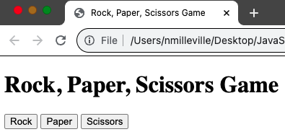
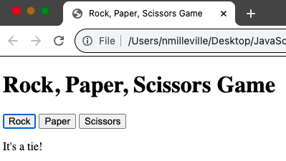
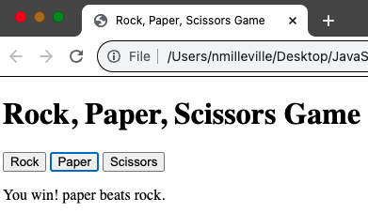
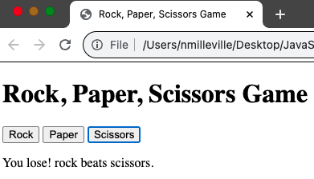
Rock, Paper, Scissors- Website View
Total Points: __/40 pts

Slide 6
Part 2- Put A Twist On It

Slide 7
Put A Twist On It
Directions:
Open up Activity RockPaperScissors.html.
You can now add FIVE twists to this previous coding game project.
This twist aims to show you can add small changes to the coding project and see if it will still operate online.
Be sure to save and run your coding to ensure it works correctly.
Saving Instructions:
Save a new file for this twist activity. Title the file as “Twist-RockPaperScissors.html” after completing to your student drive.
Take a screenshot of your coding and webpage. Paste the picture into the slots on this slide.
Answer the question of what you did to put a twist on this coding.
Turn in this slide with your coding when done.

Slide 8
Coding Key
Insert Picture Here
Share your put a twist on it coding key on this slide.
Total Points: __/25 pts (5 points for each twist)

Slide 9
Website View
Insert Picture Here
Share your put a twist on it website view on this slide.
Total Points: __/10 pts

Slide 10
What 5 twists did you make to the rock, paper, scissors game?
Share You Answer Here:
Total Points: __/10 pts

